Slide 1
LOAM: Lidar Odometry and Mapping in Real-time
Jaeman Han

Slide 2
Introduction
the only motion of the lidar is to rotate a laser beam, registration of the point cloud is simple.
Problem : if the lidar itself is moving
the range measurements are received at different times, and errors in motion estimation can cause mis-registration of the resulting point cloud.
When the lidar scan rate is high compared to its extrinsic motion, motion distortion within the scans can often be neglected.
Goal
low-drift and low-computational complexity without the need for high accuracy ranging or inertial measurements.
Not using loop closure

Slide 3
Idea of LOAM
The key idea is the division of the complex problem of simultaneous localization and mapping, by two algorithms.
The parallel algorithm structure ensures feasibility of the problem to be solved in real-time
Odometry
An odometry algorithm estimates velocity of the lidar and corrects distortion in the point cloud
correspondences of the feature points are found by ensuring fast computation.
One algorithm performs odometry at a high frequency but low fidelity to estimate velocity of the lidar.
Mapping
a mapping algorithm matches and registers the point cloud to create a map.
When running at a lower frequency, the mapping algorithm is able to incorporate a large number of feature points and use sufficiently many iterations for convergence

Slide 4

NOTATIONS AND TASK DESCRIPTION
The problem addressed
to perform egomotion estimation with point cloud perceived by a 3D lidar.
build a map for the traversed environment
Define
Sweep : the lidar completes one time of scan coverage
K: k ∈ Z + to indicate the sweeps
: to indicate the point cloud perceived during sweep k
출처:https://www.kudan.io/blog/3d-lidar-slam-the-basics/

Slide 5

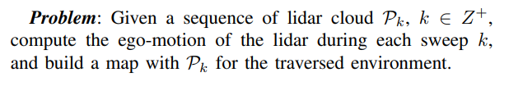
NOTATIONS AND TASK DESCRIPTION
define two coordinate systems as follows.
Lidar coordinate system {L} is a 3D coordinate system with its origin at the geometric center of the lidar.
The x axis is pointing to the left, the y-axis is pointing upward, and the z-axis is pointing forward.
The coordinates of a point
World coordinate system {W} is a 3D coordinate system coinciding with {L} at the initial position.
The coordinates of a point

Slide 6
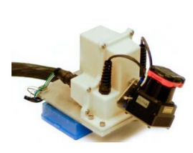
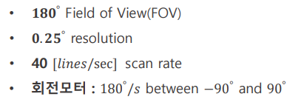
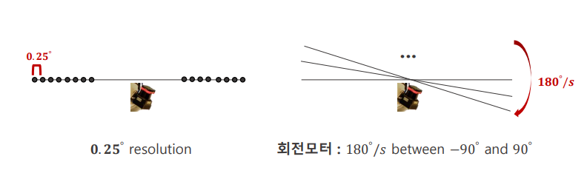
Lidar Hardware
a Hokuyo UTM-30LX laser scanner.
https://www.youtube.com/watch?v=8ezyhTAEyHs&t=14s

Slide 7
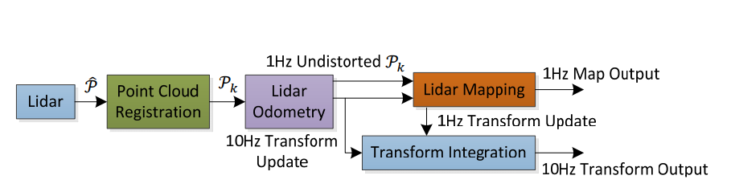

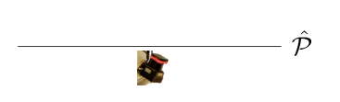
Software System Overview
:the points received in a laser scan

Slide 8

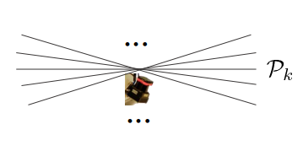
Software System Overview
: the points received in a laser scan
:The combined point cloud during sweep k

Slide 9

Software System Overview
:The lidar odometry takes the point cloud and computes the motion of the lidar between two consecutive sweeps.
The outputs are further processed by lidar mapping, which matches and registers the undistorted cloud onto a map at a frequency of 1Hz.

Slide 10
Software System Overview
the pose transforms published by the two algorithms are integrated to generate a transform output around 10Hz, regarding the lidar pose with respect to the map.

Slide 11

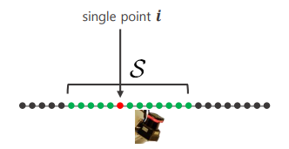
Lidar Odometry
Feature Point Extraction
We select feature points that are on sharp edges and planar surface patches.
Let i be a point in , and let be the set of consecutive points of i returned by the laser scanner in the same scan.
i :

Slide 12
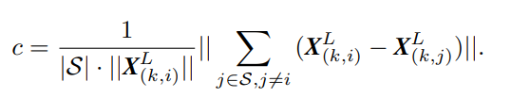
Lidar Odometry
Feature Point Extraction
Define a term to evaluate the smoothness of the local surface
The points in a scan are sorted based on the c values
feature points are selected with the maximum c’s, namely, edge points and the minimum c’s, namely planar points.

Slide 13
Lidar Odometry
Feature Point Extraction
To evenly distribute the feature points within the environment
separate a scan into four identical subregions
Each subregion can provide maximally 2 edge points and 4 planar points.
point i can be selected as an edge or a planar point only if its c value is larger or smaller than a threshold.
the number of selected points does not exceed the maximum.

Slide 14
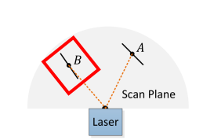
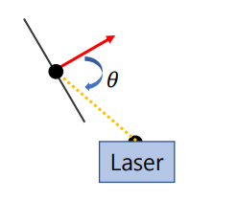
Lidar Odometry
Feature Point Extraction
Outlier
Avoid points on local planar surfaces that are roughly parallel to the laser beams

Slide 15
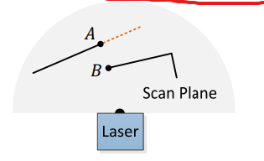
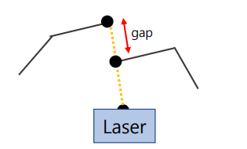
Lidar Odometry
Feature Point Extraction
Outlier
Avoid points on that are on boundary of occluded surfaces

Slide 16
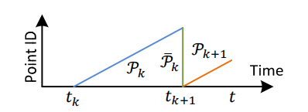


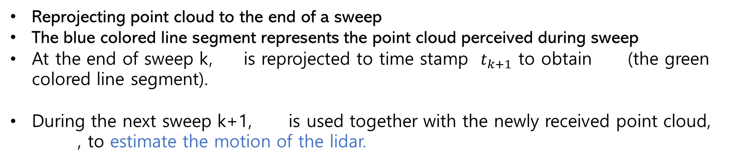
Finding Feature Point Correspondence
Reprojecting point cloud to the end of a sweep
The blue colored line segment represents the point cloud perceived during sweep
At the end of sweep k, is reprojected to time stamp $t_{k+1}$ to obtain (the green colored line segment).
During the next sweep k+1, is used together with the newly received point cloud,
, to estimate the motion of the lidar.

Slide 17

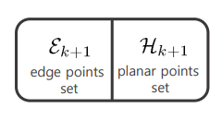


Finding Feature Point Correspondence
assume that both and are available for now
finding correspondences between the two lidar clouds.
It is to find the correspondences between and .

Slide 18
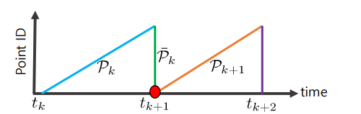




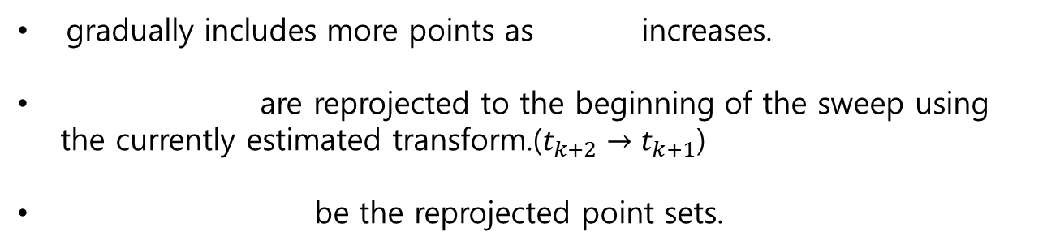
Finding Feature Point Correspondence
at the beginning of sweep k+1, is an empty set
gradually includes more points as increases.
are reprojected to the beginning of the sweep using
the currently estimated transform.($t_{k+2}→t_{k+1}$)
be the reprojected point sets.

Slide 19



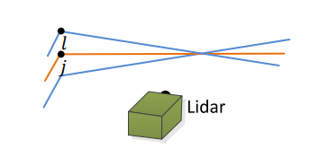
Finding Feature Point Correspondence
For each point in ,we are going to find the closest neighbor point in
i :
j be the closest neighbor of i in
l be the closest neighbor of i in the two consecutive scans to the scan of j
a single scan cannot contain more than one points from the same edge line.
i

Slide 20


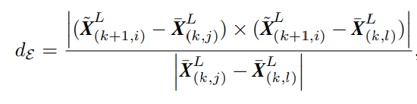

Finding Feature Point Correspondence
to verify both j and l are edge points, we check the smoothness of the local surface based on curvature
if (j, l) is the corresponding edge line, compute distance of between and
are the coordinates of points I, j and l in {L}

Slide 21

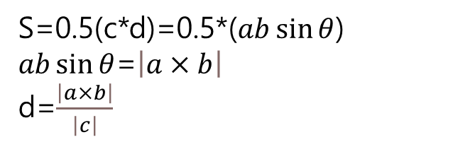

Finding Feature Point Correspondence
a
b
d
$$l$$
$$j$$
c
S=0.5(c*d)=0.5*($ab\sin{θ}$)
$ab\sin{θ}$=$\left|a×b\right|$
d=$\frac{\left|a×b\right|}{\left|c\right|}$

Slide 22

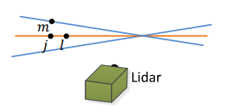
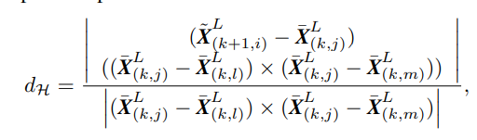
Finding Feature Point Correspondence
planar patch
i :
j be the closest neighbor of i in
l and m, as the closest neighbors of i, one in the same scan of j, and the other in the two consecutive scans to the scan of j.
three points are non-collinear.
i

Slide 23
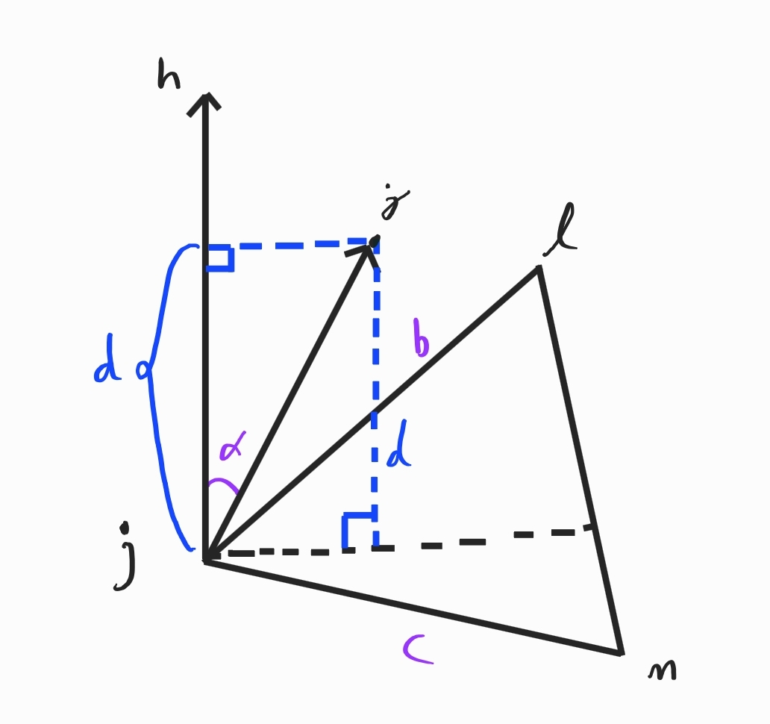

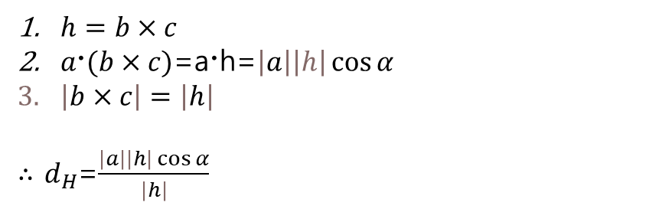
Finding Feature Point Correspondence
planar patch
a
$h=b×c$
$a〮(b×c)$=a〮h=$\left|a\right|\left|h\right|\cos{α}$
$\left|b×c\right|=\left|h\right|$
$∴$ $d_{H}$=$\frac{\left|a\right|\left|h\right|\cos{α}}{\left|h\right|}$

Slide 24



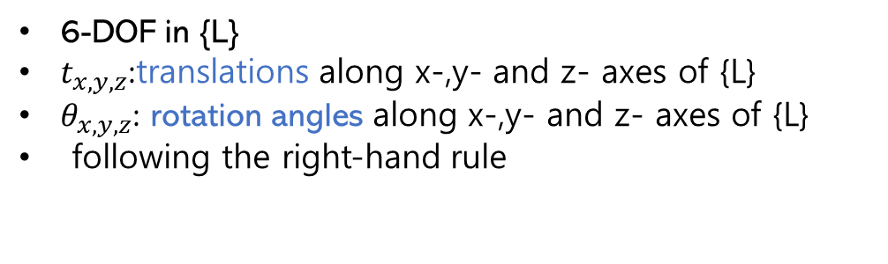
Motion Estimation
The lidar motion is modeled with constant angular and linear velocities during a sweep.
This allows us to linear interpolate the pose transform within a sweep for the points that are received at different times.
define
the lidar pose transform between [ $t_{k+1}$, t ].
6-DOF in {L}
$t_{x,y,z}$:translations along x-,y- and z- axes of {L}
$θ_{x,y,z}$: rotation angles along x-,y- and z- axes of {L}
following the right-hand rule

Slide 25


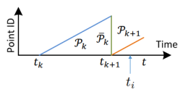



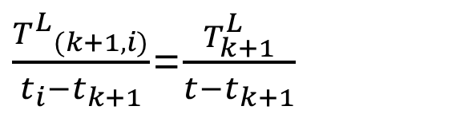
Motion Estimation
Compute ${T^{L}}_{(k+1,i)}$ by linear interpolation of $T_{k+1}^{L}$
Given
: be the pose transform between [$t_{k+1}$,$t_{i}$ ]
$$t_{k+1}$$
$$t_{i}$$
t
$\frac{{T^{L}}_{(k+1,i)}}{t_{i}−t_{k+1}}$=$\frac{T_{k+1}^{L}}{t−t_{k+1}}$

Slide 26
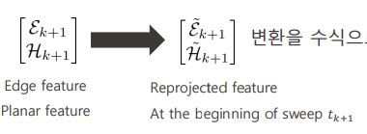







Motion Estimation
To solved the lidar motion, we need to establish a geometric relationship
between
By linear interpolation
Want relationship
: the coordinates of a point I in or
: the corresponding point in

Slide 27
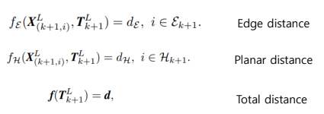
Motion Estimation
each row of f corresponds to a feature point
d contains the corresponding distances.
Levenberg-Marquardt 방식으로 최적화를 수행한다

Slide 28
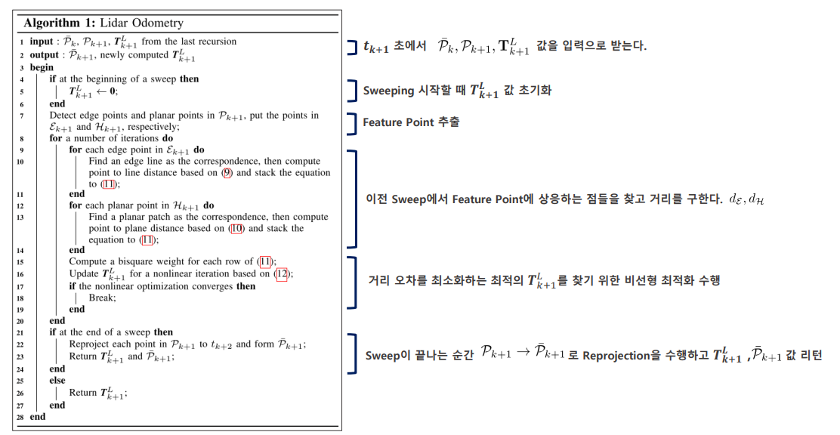

Slide 29
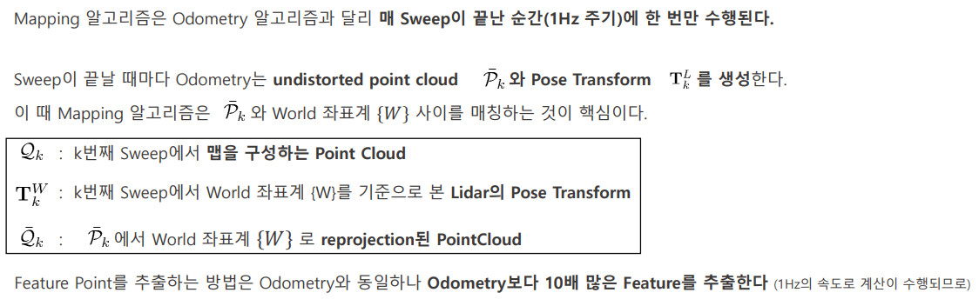
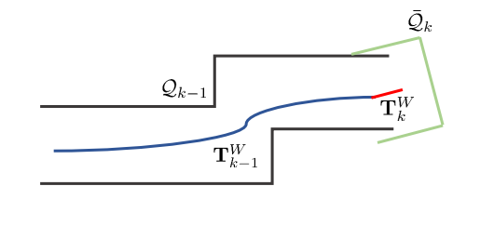
Mapping

Slide 30
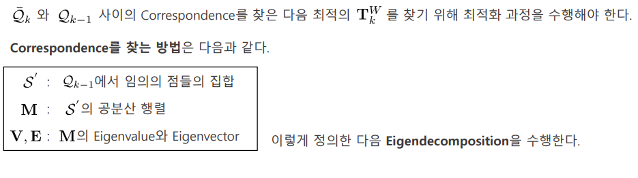
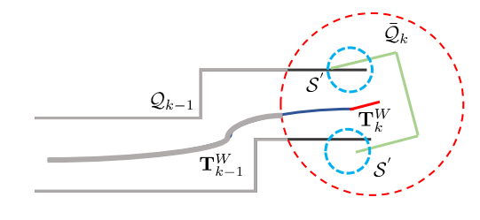
Mapping

Slide 31
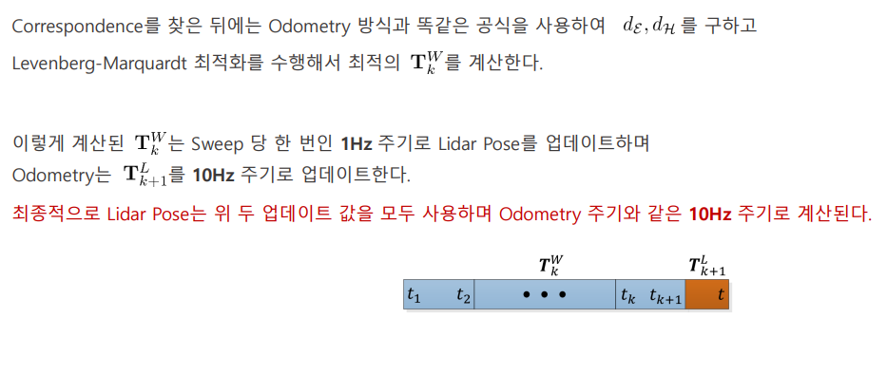
Mapping

